Slide 1
Discrete Structures
Instructor: Zubaria Asma
Course Code: CS-335
Credit Hours: 3(3-0)
Lecture # 18

Slide 2
Types of Relation

Slide 3
RELATION
Let A and B be sets. The binary relation R from A to B is a subset of A × B. When (a, b) ∈R, we say ‘a’ is related to ‘b’ by R, written aRb. Otherwise, if (a, b) ∉R, we write a R b.
Let A = {1, 2}, B = {1, 2, 3}
Then A × B = {(1, 1), (1, 2), (1, 3), (2, 1), (2, 2), (2, 3)}
Let R1={(1,1), (1, 3), (2, 2)}
R2={(1, 2), (2, 1), (2, 2), (2, 3)}
R3={(1, 1)}
R4= A × B
R5= ∅ if relation does not exist
All being subsets of A × B are relations from A to B.
Notes:
If we find the Cartesian product between two sets then it means its relation

Slide 4
Types of Relation- Reflexive Relation
Let R be a relation on a set A
R is reflexive if and only if, for all a ∈ A, (a, a) ∈R or equivalently aRa
Each element of A is related to itself

Slide 5
Remarks
R is not reflexive iff there is an element “a” in A such that (a, a) ∉R. That is, some element “a” of A is not related to itself

Slide 6
Example
Let A = {1, 2, 3, 4} and define relations R1, R2, R3, R4 on A as follows:
R1 = {(1, 1), (3, 3), (2, 2), (4, 4)}
R2 = {(1, 1), (1, 4), (2, 2), (3, 3), (4, 3)}
R3 = {(1, 1), (1, 2), (2, 1), (2, 2), (3, 3), (4, 4)}
R4 = {(1, 3), (2, 2), (2, 4), (3, 1), (4, 4)}
Identify which relation is reflexive?
Notes:
R1
is reflexive, since (a, a) ∈R1 for all a ∈A.
R2
is not reflexive, because (4, 4) ∉R2.
R3
is reflexive, since (a, a) ∈R3 for all a ∈A.{ the rest relation may exist but itself relation must exist}
R4
is not reflexive, because (1, 1) ∉R4, (3, 3) ∉R4

Slide 7
DIRECTED GRAPH OF A REFLEXIVE RELATION
The directed graph of every reflexive relation includes an arrow from every point to the point itself (i.e., a loop)
Example: Draw directed graph of following relations
R1 = {(1, 1), (3, 3), (2, 2), (4, 4)}
R2 = {(1, 1), (1, 4), (2, 2), (3, 3), (4, 3)}
R3 = {(1, 1), (1, 2), (2, 1), (2, 2), (3, 3), (4, 4)}
R4 = {(1, 3), (2, 2), (2, 4), (3, 1), (4, 4)}

Slide 8
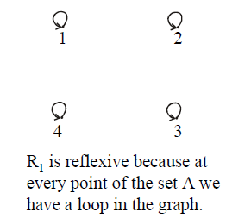
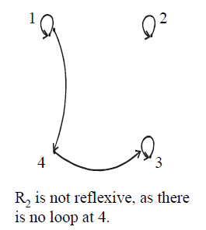
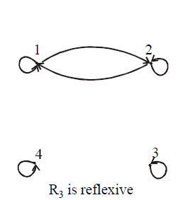
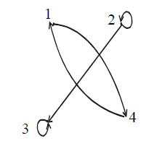
G

Slide 9
MATRIX REPRESENTATION OF A REFLEXIVE RELATION
Let A = {a1, a2, …, an}.
A Relation R on A is reflexive if and only if (ai, aj) ∈R ∀ i=1,2, …,n
Accordingly, R is reflexive if all the elements on the main diagonal of the matrix M representing R are equal to 1

Slide 10
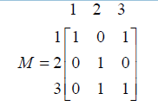
Example
The relation R = {(1,1), (1,3), (2,2), (3,2), (3,3)} on A = {1,2,3} represented by the following matrix M, is reflexive
Notes:
1 in diagonal of a matrix

Slide 11
SYMMETRIC RELATION
Let R be a relation on a set A. R is symmetric if, and only if, for all a, b ∈ A, if (a, b)∈R, then (b, a) ∈R. That is, if aRb then bRa
Remarks:
R is not symmetric iff there are elements a and b in A such that (a, b) ∈R, but (b, a) ∉R.

Slide 12
Example
Let A = {1, 2, 3, 4} and define relations R1, R2, R3, and R4 on A as follows
R1 = {(1, 1), (1, 3), (2, 4), (3, 1), (4,2)}
R2 = {(1, 1), (2, 2), (3, 3), (4, 4)}
R3 = {(2, 2), (2, 3), (3, 4)}
R4 = {(1, 1), (2, 2), (3, 3), (4, 3), (4, 4)}

Slide 13
Solution
Then R1 is symmetric because for every order pair (a, b) in R1 also have (b, a) in R1. For example, we have (1, 3) in R1 then we have (3, 1) in R1.
R2 is also symmetric. We say it is vacuously true.
R3 is not symmetric, because (2,3) ∈ R3 but (3,2) ∉ R3.
R4 is not symmetric because (4,3) ∈ R4 but (3,4) ∉ R4.

Slide 14
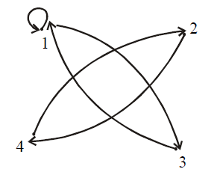
DIRECTED GRAPH OF A SYMMETRIC RELATION
For a symmetric directed graph whenever there is an arrow going from one point of the graph to a second, there is an arrow going from the second point back to the first.

Slide 15
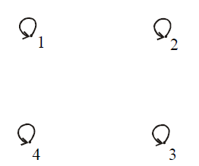
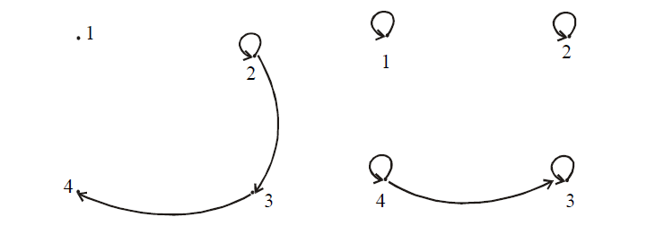
Directed Graph
R1 = {(1, 1), (2, 2), (3, 3), (4, 4)}
R2 = {(2, 2), (2, 3), (3, 4)}
R3 = {(1, 1), (2, 2), (3, 3), (4, 3), (4, 4)}
Notes:
All reflexive are symmetric relation

Slide 16

MATRIX REPRESENTATION OF A SYMMETRIC RELATION
Let A = {a1, a2, …, an}.
The relation R on A is symmetric if and only if for all ai, aj ∈ A, if (ai, aj) ∈R then (aj, ai)∈R
Accordingly, R is symmetric if the elements in the ith row are the same as the elements in the ith column of the matrix M representing R.
More precisely, M is a symmetric matrix i.e.

Slide 17
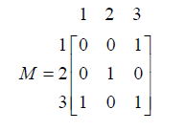
The relation R = {(1,3), (2,2), (3,1), (3,3)} on
A = {1,2,3} represented by the following matrix M is symmetric

Slide 18
TRANSITIVE RELATION
Let R be a relation on a set A. R is transitive if and only if for all a, b, c ∈A, if (a, b) ∈R and (b, c) ∈R then (a, c) ∈R.
That is, if aRb and bRc then aRc.
In words, if any one element is related to a second and that second element is related to a third, then the first is related to the third
Note: The “first”, “second” and “third” elements need not to be distinct

Slide 19
Example
Idenify transitive relation:
R1 = {(1, 1), (1, 2), (1, 3), (2, 3)}
R2 = {(1, 2), (1, 4), (2, 3), (3, 4)}
R3 = {(2, 1), (2, 4), (2, 3), (3,4)}
R1 is transitive.
R2 is not transitive since (1,2) and (2,3) ∈ R2 but (1,3) ∉ R2.
R3 is transitive.

Slide 20
DIRECTED GRAPH OF A TRANSITIVE RELATION
For a transitive directed graph, whenever there is an arrow going from one point to the second, and from the second to the third, there is an arrow going directly from the first to the third

Slide 21
Let A = {1, 2, 3, 4} and define relations R1, R2 and R3 on A by the directed graphs:
R1 = {(1, 1), (1, 2), (1, 3), (2, 3)}
R2 = {(1, 2), (1, 4), (2, 3), (3, 4)}
R3 = {(2, 1), (2, 4), (2, 3), (3,4)}

Slide 22
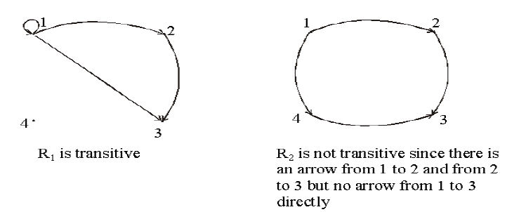
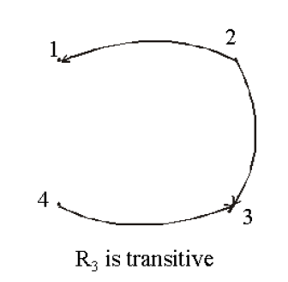

Slide 23

THANK YOU

